Slide 1
Intermediate Python (Part 2)
Workshop Lead: Benjamin Z. Rudski
Date: July 18, 2024

Slide 2

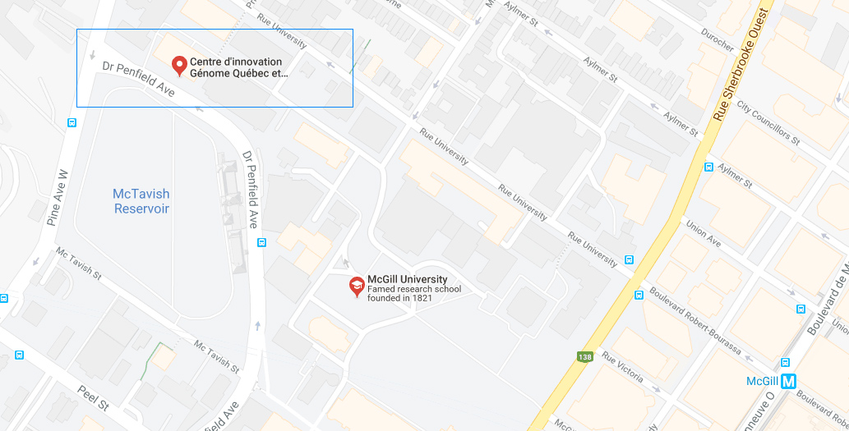

Mission statement: deliver quality workshops designed to help biomedical researchers develop the skills they need to succeed.
Location: 740 Dr. Penfield Avenue, Montreal, Quebec
Scan the QR code to sign up
for our mailing list
Contact: workshop-micm@mcgill.ca

Slide 3
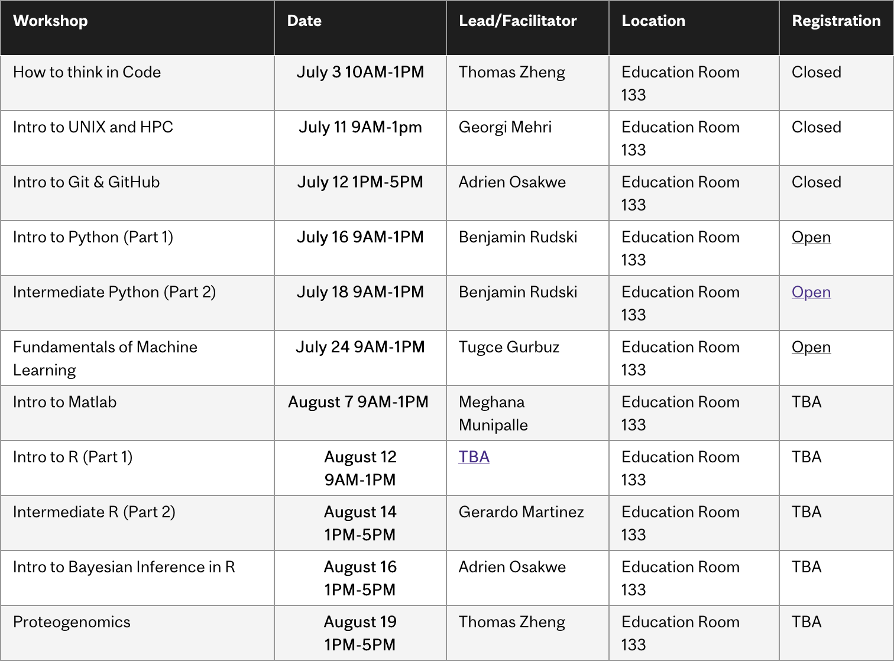
Summer 2024 Workshop Series
https://www.mcgill.ca/micm/training/workshops-series

Slide 4
About me
BSc from McGill in Hon. CS/Bio, Minor Math
Third-year PhD candidate in Quantitative Life Sciences (QLS)
Research on trabecular bone structure in the Reznikov Lab, McGill Bioengineering
3D image processing and analysis
Programming is an almost-daily task in my life!
https://github.com/bzrudski

Slide 5
Outline
0. Module 0 – Welcome (10 minutes)
Introduction & overview
Motivational problem context: Protein analysis.
Module 1 – Introduction to Functions (45 minutes)
Function Overview
Writing Custom Functions
Documenting Functions
Exercise
Module 2 – Advanced Python Features (45 minutes)
One-liners: Some Python Syntactic Sugar
A Brief Overview of Classes
Enumerations
Introduction to Data Classes
Exercise

Slide 6
Outline
Module 3 – Introduction to NumPy Arrays (1 hour)
Introduction to Arrays
Basic Array Operations
Advanced Array Operations
Exercise
Module 4 – Visualising Data with Matplotlib (50 minutes)
Creating Plots with Matplotlib
Advanced Plotting Techniques
Exploring the Matplotlib Documentation
Exercise
Module 5 – Wrap-up (10 minutes)
What to learn next? How?
How to get help and how not to get help
Other cool programming topics

Slide 7
Module 0 Welcome & Problem Context

Slide 8
Review from Tuesday
Key concepts:
Variables
Control flow
Loops
Strings
Collections
So… is that everything there is to know?
We’ve just scratched the surface…

Slide 9
Why not just stick to simple stuff?
Real world problems get complicated…
Good news! Other people have written helpful code!
We started seeing modules. These are important!

Slide 10
Mini-Project: Analysing Proteins
Problem scenario: You analyse protein sequences from different species in both health and disease.
How can we easily process these sequences?
How can we analyse the different amino acid properties?
How can we easily visualise the results?

Slide 11
To the Notebook!

Slide 12
Module 2 Advanced Python Techniques

Slide 13
What is an Object?
Object
Attributes
Methods
Variables
Describe the object
Functions
Compute values
Alter the object

Slide 14
Objects & Classes
Object
Attributes
Methods
Object
Attributes
Methods
Class (Blueprint)
Attribute definitions
Method definitions
Object
Attributes
Methods

Slide 15
Objects & Classes
Mouse 1
15 cm
26 g
15 months
Male
Homozygous dominant
Mouse Class
Height
Weight
Age
Sex
Genotype
Actual mice.
Defines mouse.
Mouse 2
17 cm
24 g
12 months
Female
Heterozygous

Slide 16
Module 3 Introduction to NumPy Arrays

Slide 17
my_array
(0, 0) | (0, 1) | (0, 2) | (0, 3) | (0, 4) | (0, 5)
(1, 0) | (1, 1) | (1, 2) | (1, 3) | (1, 4) | (1, 5)
(2, 0) | (2, 1) | (2, 2) | (2, 3) | (2, 4) | (2, 5)
(3, 0) | (3, 1) | (3, 2) | (3, 3) | (3, 4) | (3, 5)
(4, 0) | (4, 1) | (4, 2) | (4, 3) | (4, 4) | (4, 5)
Shape: (5, 6)

Slide 18
my_array[0]?
(0, 0) | (0, 1) | (0, 2) | (0, 3) | (0, 4) | (0, 5)
(1, 0) | (1, 1) | (1, 2) | (1, 3) | (1, 4) | (1, 5)
(2, 0) | (2, 1) | (2, 2) | (2, 3) | (2, 4) | (2, 5)
(3, 0) | (3, 1) | (3, 2) | (3, 3) | (3, 4) | (3, 5)
(4, 0) | (4, 1) | (4, 2) | (4, 3) | (4, 4) | (4, 5)
Shape: (5, 6)

Slide 19
my_array[0]
(0, 0) | (0, 1) | (0, 2) | (0, 3) | (0, 4) | (0, 5)
(1, 0) | (1, 1) | (1, 2) | (1, 3) | (1, 4) | (1, 5)
(2, 0) | (2, 1) | (2, 2) | (2, 3) | (2, 4) | (2, 5)
(3, 0) | (3, 1) | (3, 2) | (3, 3) | (3, 4) | (3, 5)
(4, 0) | (4, 1) | (4, 2) | (4, 3) | (4, 4) | (4, 5)
Shape: (5, 6)

Slide 20
my_array[:, 0]?
(0, 0) | (0, 1) | (0, 2) | (0, 3) | (0, 4) | (0, 5)
(1, 0) | (1, 1) | (1, 2) | (1, 3) | (1, 4) | (1, 5)
(2, 0) | (2, 1) | (2, 2) | (2, 3) | (2, 4) | (2, 5)
(3, 0) | (3, 1) | (3, 2) | (3, 3) | (3, 4) | (3, 5)
(4, 0) | (4, 1) | (4, 2) | (4, 3) | (4, 4) | (4, 5)
Shape: (5, 6)

Slide 21
my_array[:, 0]
(0, 0) | (0, 1) | (0, 2) | (0, 3) | (0, 4) | (0, 5)
(1, 0) | (1, 1) | (1, 2) | (1, 3) | (1, 4) | (1, 5)
(2, 0) | (2, 1) | (2, 2) | (2, 3) | (2, 4) | (2, 5)
(3, 0) | (3, 1) | (3, 2) | (3, 3) | (3, 4) | (3, 5)
(4, 0) | (4, 1) | (4, 2) | (4, 3) | (4, 4) | (4, 5)
Shape: (5, 6)

Slide 22
my_array[1:3, 2:4]?
(0, 0) | (0, 1) | (0, 2) | (0, 3) | (0, 4) | (0, 5)
(1, 0) | (1, 1) | (1, 2) | (1, 3) | (1, 4) | (1, 5)
(2, 0) | (2, 1) | (2, 2) | (2, 3) | (2, 4) | (2, 5)
(3, 0) | (3, 1) | (3, 2) | (3, 3) | (3, 4) | (3, 5)
(4, 0) | (4, 1) | (4, 2) | (4, 3) | (4, 4) | (4, 5)
Shape: (5, 6)

Slide 23
my_array[1:3, 2:4]
(0, 0) | (0, 1) | (0, 2) | (0, 3) | (0, 4) | (0, 5)
(1, 0) | (1, 1) | (1, 2) | (1, 3) | (1, 4) | (1, 5)
(2, 0) | (2, 1) | (2, 2) | (2, 3) | (2, 4) | (2, 5)
(3, 0) | (3, 1) | (3, 2) | (3, 3) | (3, 4) | (3, 5)
(4, 0) | (4, 1) | (4, 2) | (4, 3) | (4, 4) | (4, 5)
Shape: (5, 6)

Slide 24
my_array[0:5:2]?
(0, 0) | (0, 1) | (0, 2) | (0, 3) | (0, 4) | (0, 5)
(1, 0) | (1, 1) | (1, 2) | (1, 3) | (1, 4) | (1, 5)
(2, 0) | (2, 1) | (2, 2) | (2, 3) | (2, 4) | (2, 5)
(3, 0) | (3, 1) | (3, 2) | (3, 3) | (3, 4) | (3, 5)
(4, 0) | (4, 1) | (4, 2) | (4, 3) | (4, 4) | (4, 5)
Shape: (5, 6)

Slide 25
my_array[0:5:2]
(0, 0) | (0, 1) | (0, 2) | (0, 3) | (0, 4) | (0, 5)
(1, 0) | (1, 1) | (1, 2) | (1, 3) | (1, 4) | (1, 5)
(2, 0) | (2, 1) | (2, 2) | (2, 3) | (2, 4) | (2, 5)
(3, 0) | (3, 1) | (3, 2) | (3, 3) | (3, 4) | (3, 5)
(4, 0) | (4, 1) | (4, 2) | (4, 3) | (4, 4) | (4, 5)
Shape: (5, 6)

Slide 26
Concluding Remarks

Slide 27
To summarize
Functions allow us to package up behaviour to use over and over.
Data classes and enumerations help us easily represent the real world in code.
NumPy arrays allow easily storing many numbers and performing operations without having to loop.
Matplotlib can be used to generate many different types of plots.
Now you are ready to:
Define your own functions to simplify important tasks.
Define new classes to help represent new types of data.
Use NumPy arrays to perform large calculations.
Use Matplotlib to easily visualise your results.

Slide 28
Acknowledgements
Thank you to MiCM for giving me this opportunity and for helping me along the way.
Thank you to the professors from the McGill School of Computer Science for helping me along my programming journey and for inspiring me to share my programming experience with others.
Thank you to Professor Mathieu Blanchette, whose COMP 204 course helped introduce me to Python (back in Fall 2018).

